Slide 1
Chatbot based Medial Expert System
By
Group no 39
Bishal Kumar (B120234231)
Jaideep Kekre (B120234299)
Sameer Deshmukh (B120234250)
Guide : C.A Laulkar

Slide 2
Contents
Section One : Deals with Idea of the Project .
Section Two : Deals with implementation details

Slide 3
Activities Performed
Participated in a medical conference at BJ Medical College. (Top 30)
Interacted with Doctors .
Participated in Avishkar -2015 (Zonal)
Participated in Persistent Hackathon (level 1 )

Slide 4
Section One (Idea )
What are we trying to solve ?
How are we trying to solve it ?
How will it help the Doctor ?
How will it help the Patient ?
Government Initiatives ?
Literature Survey
Problem Statement
Aims and Objectives

Slide 5
INTRODUCTION

Slide 6
What are we trying to solve ?
Today’s doctor patient ratio : less than 1:1000
A doctor has to give the same attention and time to both a patient with a minor viral infection and one with Cancer .
Seasonal cases with similar symptoms clustered around geographic areas like Dengue , Viral infections, allerges etc. overwhelm the local doctors during change of seasons
Information overload on Doctors .
History taking takes up too much time .

Slide 7
How do we plan to solve it ?
We are implementing a Chat-bot i.e. a software that can talk to patients.
The Chat-bot will be the first level of medical interaction (History Taking)
The Chat-bot will understand what the patient is suffering from .
Using its medical knowledge , it will perform a diagnosis .
The patient will be informed the prognosis after verification from a real doctor .
Medico – Legal, Ethical issues addressed.

Slide 8
Ontology Engineering
Ontology engineering in computer science and information science is a field which studies the methods and methodologies for building ontologies: formal representations of a set of concepts within a domain and the relationships between those concepts.
A large-scale representation of abstract concepts such as actions, time, physical objects and beliefs would be an example of ontological engineering.
Core ideas and objectives of ontology engineering are also central in conceptual modeling.

Slide 9
How will it help the Doctor ?
Improves quality of first Doctor Patient interaction .
Provide structured view of the patients situation with likely prognosis .
Suggested screening out of minor aliments , and prioritizing of targeted healthcare to those with serious aliments.
Provides a large amount of medical knowledge in a structured form , in a conversational interface ie your own virtual assistant .

Slide 10
How will it help the patient ?
A paramedic or Anganwadi can be easily taught how to interact with the Chat-Bot ( due to zero learning curve )
Time in the waiting room can be utilized better.
She or He can serve a large(connected) rural area with a doctor sitting in Delhi .
The patient can be given care even in the remotest corners of the country , even areas without network connectivity . The structured, collected data and diagnosis can be securely relayed to a Doctor in Mumbai for verification when the Anganwadi reaches a networked area .

Slide 11
Literature Survey

Slide 12
Literature Survey
Comparative study of following papers:
Expert systems research – modelling the medical decision making process
Ontology-based medical chatbot system
Temporal reasoning in medical expert systems
Expert systems in medical diagnostics
Real conversation with artificial intelligence

Slide 13
Towards an ontology based chatbot
Talks about an on-going ontology based chatbot that relies on sematic web and NLP models to support user – machine dialogical interaction.
It does this by using 3 modules – a knowledge based system, question interpretation and Natural Language Generation.
Ontology is a formal naming and definition of the types, properties and interrelationships between entities.
Hallili - 2014

Slide 14
Temporal reasoning in medical expert systems
Temporal reasoning is important because the final diagnositics depends heavily on the sequence of the symptoms.
Temporal reasoning & logic is a system of rules for representing and reasoning about propositions qualified in terms of time – for example “I am _always_ hungry”.
This paper develops temporal relationships between symptoms based on fuzzy set theory.
I. S. Kohane - 1987

Slide 15
Expert system research, modelling the medical decision making process
This papers reviews AI and expert systems to acquaint the reader with the field and to suggest ways in which this research will eventually be applied to advanced medical monitoring.
It states that an expert system is a system that contains and can apply specialized knowledge. It uses this knowlegde to make suggestions to users who may not have the full range of expertise available
Shortliffe, Fagan - 1982

Slide 16
Expert systems in medical diagnostics
This paper analyses and precisely defies the functioning of a medical expert system.
It says that an expert system is a program that acts similarly to an expert in some subject field.
The difference between ‘expert systems’ and ‘knowledge based systems’ is that an expert system is able to explain its behaviour to a user.
The paper also analyses different approaches taken for implementing some medical expert systems.
Kiseleva, Toropchina - 2014

Slide 17
Real conversations with Artificial Intelligence
This paper analyses how the quality of conversations changes between human-human and human-chatbot interactions.
They conclude that while human communication skills translate easily to a computer, there were many differences between the quality and the content of these conversations.
It was found that most human-chatbot interactions were short and lacked richness of vocabulary, and usually involved more profanity.
Hill, Ford, Farreras - 2015

Slide 18
Problem Statement
Creation of a medical expert system that uses pre-existing knowledge to calculate the probabilistic score of a patient having a particular disease . The Expert system will use algorithms to ask the next most relevant question.

Slide 19
Aims and Objectives
The aim of this project is to create a chat bot that serves a vast amount of known medical facts regarding diseases, symptoms, disease patterns, risk criteria's, etc. in a QA interface.
To implement a conversational system that is as close to human interaction as possible.

Slide 20
Section Two (Implementation)
Framework
System Requirements
Modules
Cursory overview of Algorithms
Working
UML Diagrams
Software Requirements Specifications

Slide 21
Hardware & Software Requirement
Python 2.7
Telegram Server
Front end will be the Telegram App
Internet Connection
UNIX-like operating system capable of running a python interpreter and compiling python libraries. Hardware can be abstracted away due to portable nature of python.
Multiple data structures to store expert medical information.

Slide 22
Telegram Bots
What is Telegram
What are telegram Bots ?
What can I do with bots ?
Example .

Slide 23


CHATBOT
Telegram
Server
Medibot Telegram Poller
Dispatcher
Done
User
Core
Data
Store
Disease Interface
Expert System
Doctor
Skynet
Email
Doctor

Slide 24
MODULES

Slide 25
Modules
Server Module
Dispatcher
Core
Expert System
DrSkyNet
Disease InterFace
Supporting sub modules
Database Modules
Redis server

Slide 26
Server Module
Polls the Telegram server for incoming messages.
Stateless
Extracts the relevant data using the python-telegram-api library.
Sends data to the dispatcher for processing.
Gets the response message back from the dispatcher and sends it back to the user.

Slide 27
Server Module
Mutli-process, multi-threaded server for asynchronous receiving and sending of messages.
Uses python standard library process and multithread libraries.
Runs 3 major processes:
Telegram server polling process
Message dispatcher process
Message sender process

Slide 28
Dispatcher
Enables multi-tasking
Stateful
Maps User to Core object
Session Management .
Working : Maps the existing core object to incoming,outgoing message based on chat_id as key .

Slide 29
Core
Runs expert system
Stateless
Each user has one Core object
Passes user response to Expert System , and prepares system response including keyboard.
Methods : getStruct , ReadStruct , Response

Slide 30
Expert System
Runs DoctorSkynet
State full
Bridges Core , DoctorSkynet
Each Core has one Expert System object
Gets next question to ask from DoctorSkynet
Role : To properly format the query to DoctorSkynet from Core

Slide 31
Database Module
The database module is the de facto module for every single interaction with Redis.
No function in the entire system is permitted to engage with Redis in any way other than from the database module.
There is only one database object created for the entire system in the dispatcher, references of which are passed to classes that need it.
The database object encapsulates the Redis DB connection and exposes various other methods that make database interaction easy and error proof.

Slide 32
Database Schema
User data in the database is primarily stored in 4 tables:
Per user basic data – stores the basic user data of users like age, weight, gender and height. Each user has his own Redis hash, which is stored in the form <chat_id + “:basic_data”>.
Per user symptom data – stores the reported symptom data of each user. The key is the symptom and the corresponding value is the number of times the user has reported that symptom. This data is unique to each user and is stored in the form <chat_id + “:symptoms”>.
Global symptom count – It is a table that stores the number of times all users have reported particular symptoms. It is a redis hash of name ‘GLOBAL_SYMPTOM_COUNT’.
Global username chat ID – It is a table that stores the usernames of users with their corresponding chat IDs. It is a redis hash of name ‘GLOBAL_USERNAME_CHATID’.

Slide 33
Disease Score and Ratio
Each disease score is the sum of the individual symptoms.
Ratio score = (Total score of disease – Total score of symptoms answered True ) / Total Score of disease
Bucket(s) with highest ratio score(s) will be returned to doctor.

Slide 34
DoctorSkynet
Returns the next question to ask based on current situation
Uses 5 algorithms : -1 , 0 , 1 , 2 , 3
State full between algorithms
Stateless inside algorithms .
Primary role : To return the next most relevant symptom based question
Side effects : Calculation of Disease probability

Slide 35
DoctorSkynet – Algorithms Pre-Requsites
Disease = Bucket
Symptoms = Elements of bucket
Least Bucket score = Highest Probability
Symptom can only be asked once .
Bucket removal based on :
CRITCAL SYMPTOM = Disease can’t be characterized without this (Score =20)
IMPORTANT SYMPTOM = Two or more of these make up the disease (Score =10)
OPTIONAL SYMPTOM = May or may not be present (Score =5)

Slide 36
Fever(20)
Fever(10)
Body Pain(10)
Fatigue(20)
Joint Pain(10)
Joint Pain(10)
Pain behind eyes(5)
Clay Colored Bowels(10)
Rash(5)
Body Pain Muscles(5)
Yellow Eyes(5)
Dengue
hepA

Slide 37
DoctorSkynet – Algorithm MINUS ONE
Role : Clustered symptom identifier
Finds the symptom that ALL the patients are suffering from .
Uses Redis table : GLObAL_SYMPTOM_COUNT
Does not interact with buckets.
Step 1 : Get all symptom , Yes count from Redis via ORM
Step 2 : Find symptom with highest Yes count
Step : Return that symptom

Slide 38
DoctorSkynet – Algorithm ZERO
Role : Most probable symptom finder , patient history based
Finds the symptom that the patients is PRONE to.
Uses Redis table: <chat_id + “:symptoms”>
Does not interact with buckets.
Step 1 : Get Patient’s historical symptom , Yes count from Redis via ORM
Step 2 : Find symptom with highest Yes count
Step : Return that symptom

Slide 39
DoctorSkynet – Algorithm ONE
Role : Find symptom with highest score across buckets
Finds the symptom that will fill largest number of buckets
Does not interact directly with buckets
Step 1 : Get symptom score dict
Step 2 : Find symptom with highest score
Step 3 : Return that symptom
Step 4 : Update buckets , remove symptom from all score dicts
Step 5 : End

Slide 40
DoctorSkynet – Algorithm TWO
Role : Find Critical symptom with highest score across buckets
Finds the symptom that will remove largest number of buckets if answered in negative .
Does not interact with bucket directly
Step 1 : Get Critical symptom score dict
Step 2 : Find symptom with highest score
Step 3 : Return that symptom
Step 4 : Update buckets , remove symptom from all score dicts
Step 5 : End

Slide 41
DoctorSkynet – Algorithm THREE
Role : Find symptom with highest cumulative remaining score in each bucket
Finds the symptoms that will fill the remaining disease .
Step 1 : Get Bucket
Step 2 : Find symptom with highest score in Bucket
Step 3 : Record that symptom , score in data structure
Step 4 : If buckets left goto step 1
Step 5 : Find symptom with highest score in data structure
Step 6 : Return that symptom

Slide 42
Sample Response Email
Question | Response
Fever | Yes, mild(101-103f)
Fatigue | No
Yellow_eyes | Yes
Yellow_nails | Yes
Consumed_contaminated_stuff | Yes
Body_chills | Yes
Body_pain | No
Body_pain_muscles | Yes
Disease | Fraction
Leptospirosis | 0.944444444444

Slide 43
WORKING

Slide 44
FEVER
JOINT PAIN
BODY PAIN
Current Score : 50
PAIN BEHIND EYES
FEVER
BODY PAIN
RASH
Current Score : 30
RASH
Current Score : 20
Current Score : 15

Slide 45
CHATBOT
Telegram
Server
Medibot Telegram Poller
Dispatcher
Done
User
Core
Data
Store
Disease Interface
Expert System
Doctor
Skynet
Email
Doctor

Slide 46
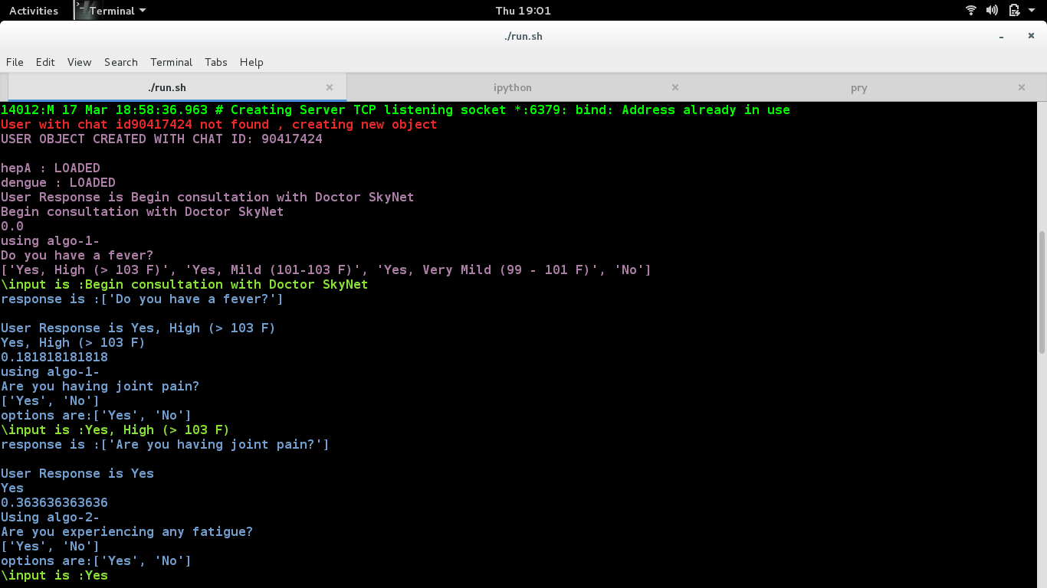
Sample Server Images-1

Slide 47
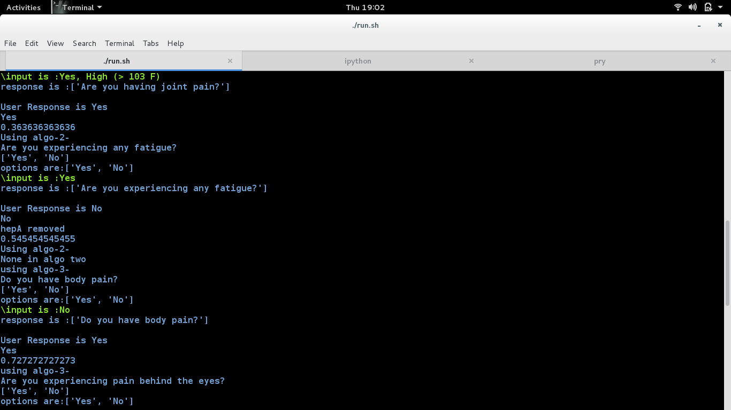
Sample Server Images -2

Slide 48
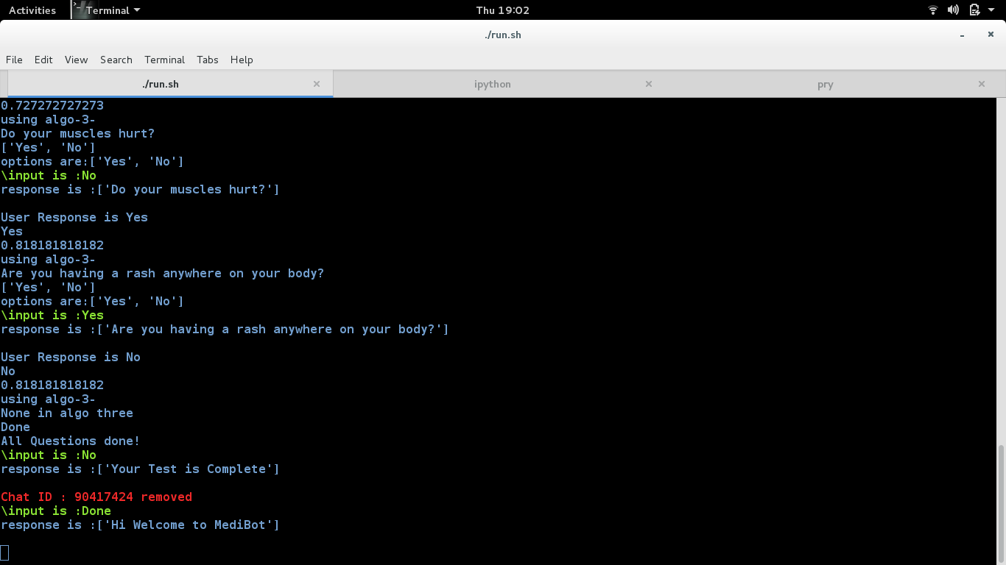
Sample Server Images -3

Slide 49
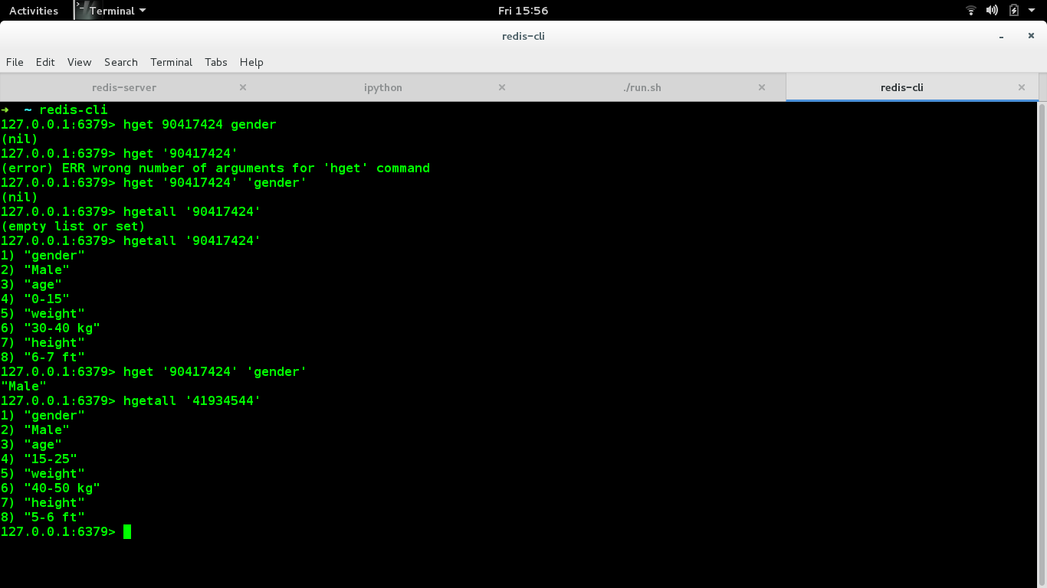
Sample Redis DB Image

Slide 50
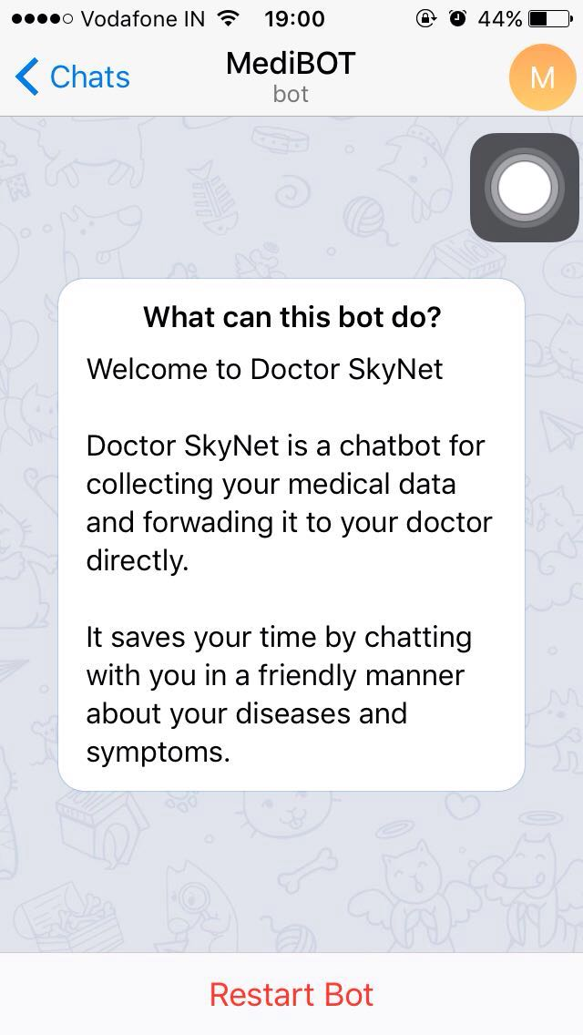
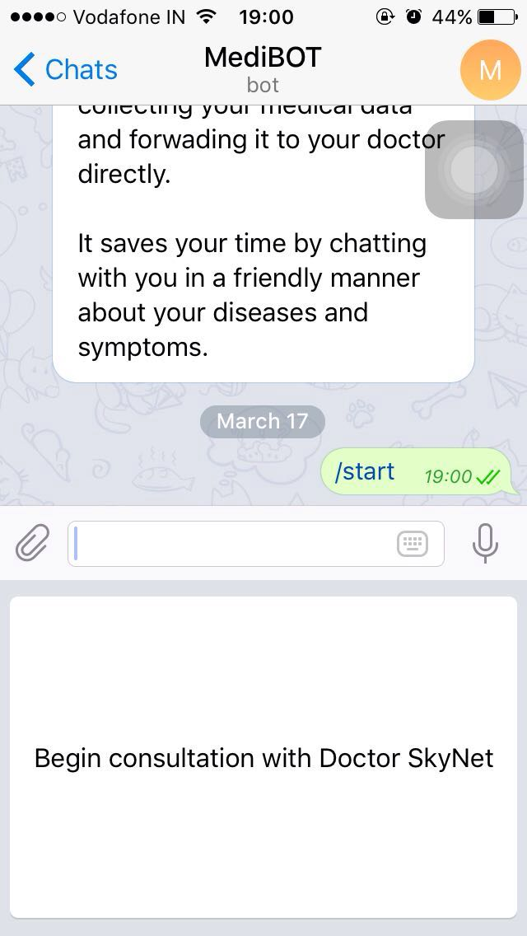
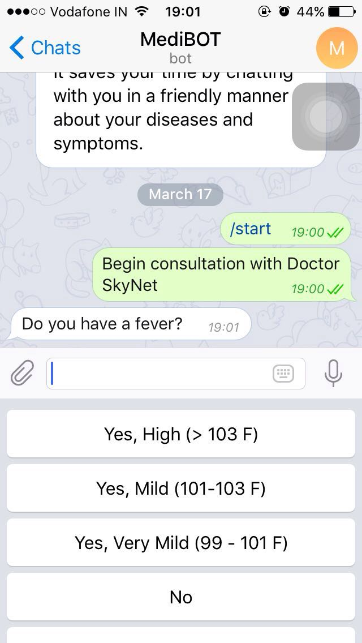
Sample User Interface Images -1

Slide 51
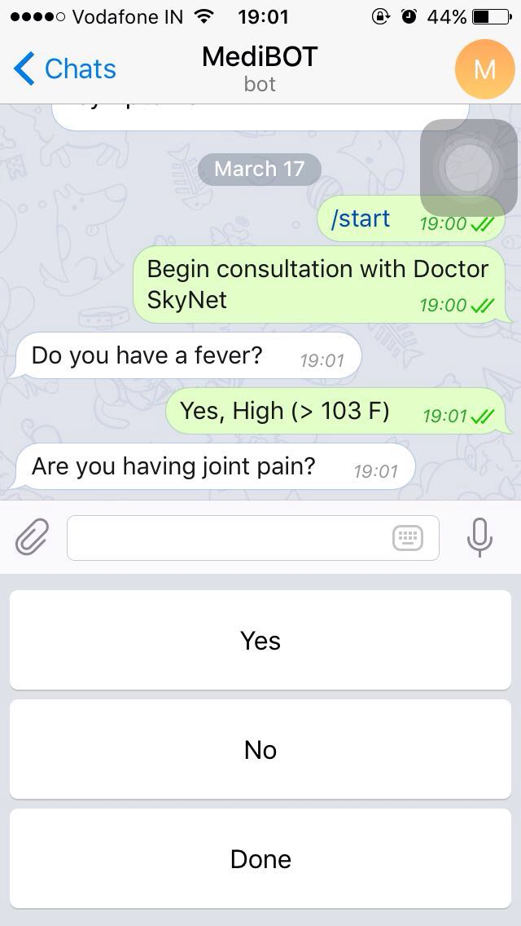
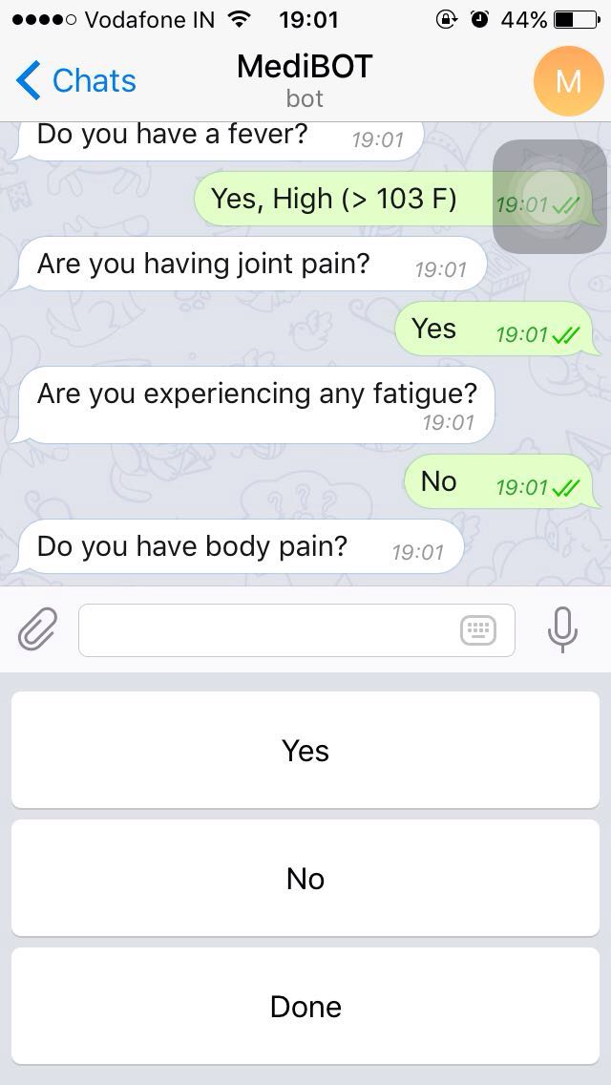
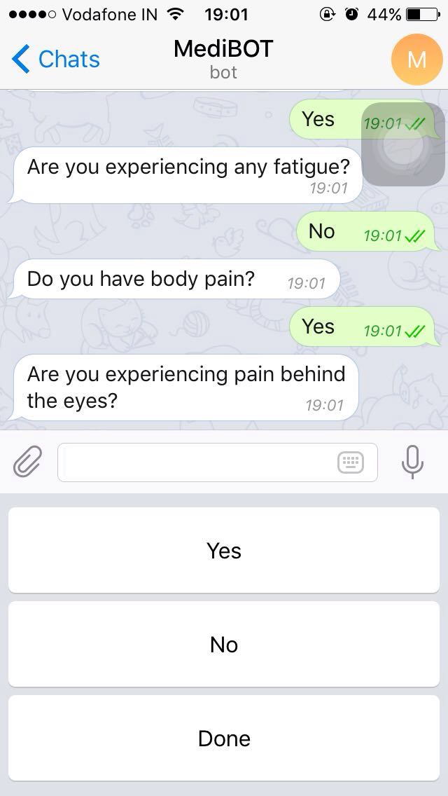
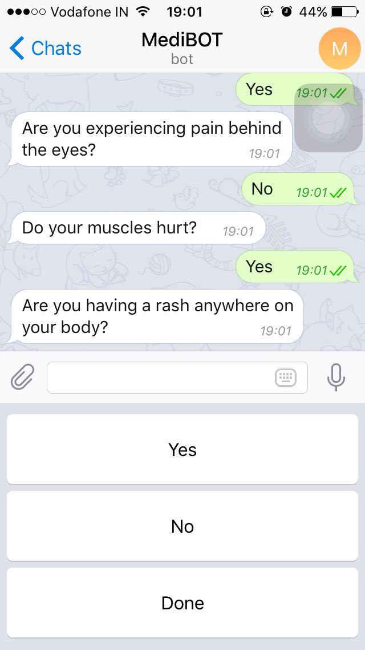
Sample User Interface Images -2

Slide 52
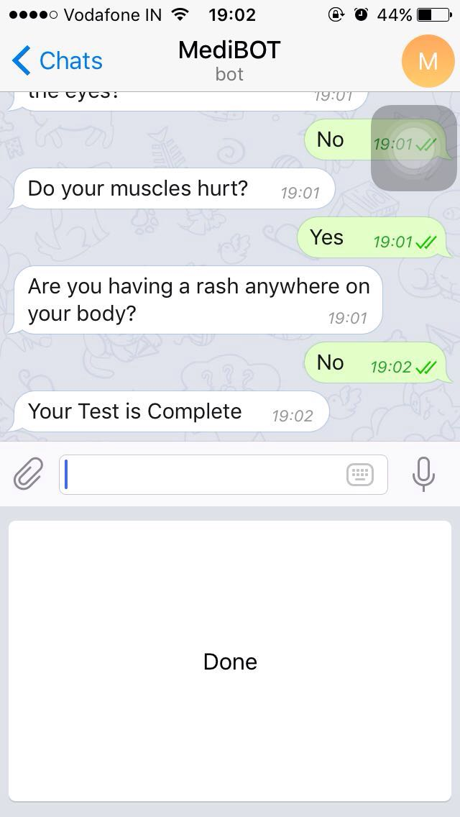
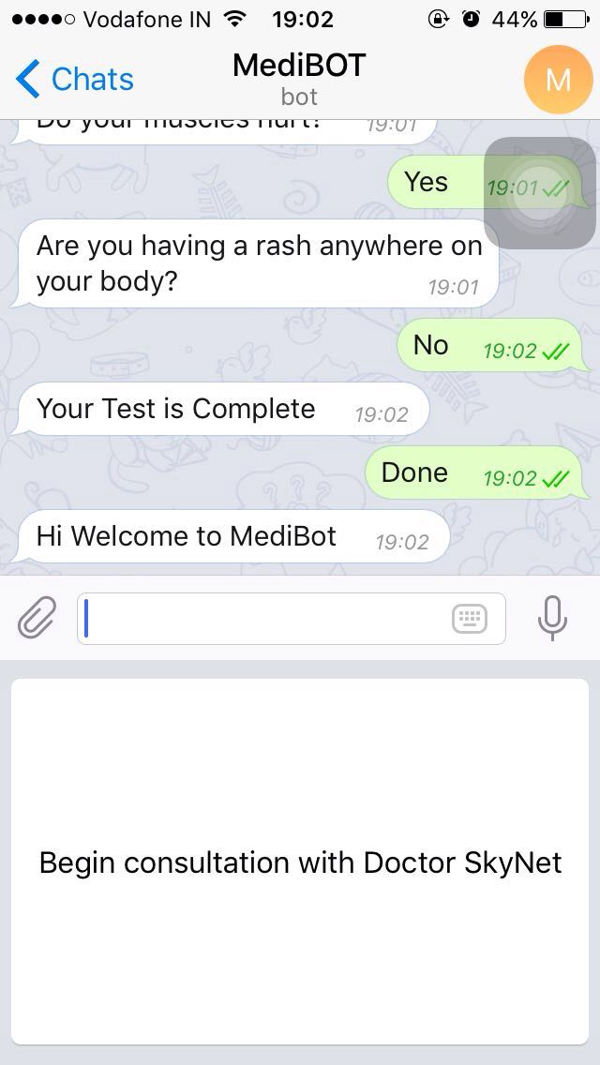
Sample User Interface Images -2

Slide 53
DOCUMENTATION

Slide 54
UML Diagrams
Click for UML

Slide 55
Software Requirements Specifications
Click to view SRS

Slide 56
References
http://www.nltk.org/
http://www.obofoundry.org/
http://www.alicebot.org/about.html
https://core.telegram.org/api

Slide 57
THANK YOU !

